Slide 1
Ethan Bishop
Goals for the week
  Test Pi HAT motor controllers on Raspberry Pi
  Integrate IMU on to Raspberry Pi
  Research 3D printing stl files for the chassis
Progress for the week
  Tested HATs for operational accuracy on Raspberry Pi
  Implemented IMU on Raspberry Pi
Goals for next week
  Research 3D printing stl files for the chassis
  Research possible ROS implementation
Hours spent on progress
  7 hours.

Slide 2
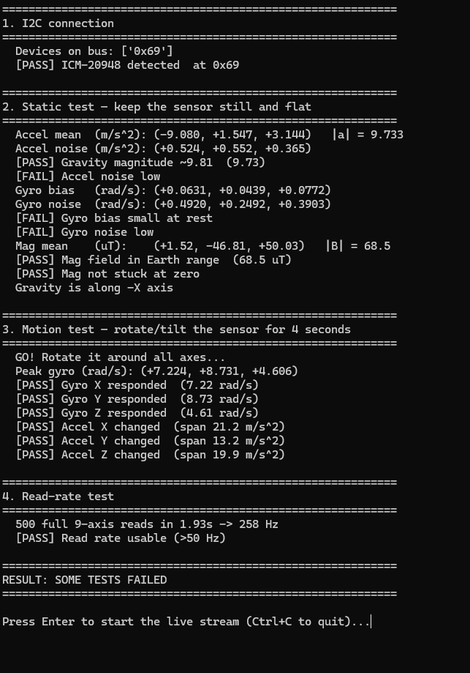
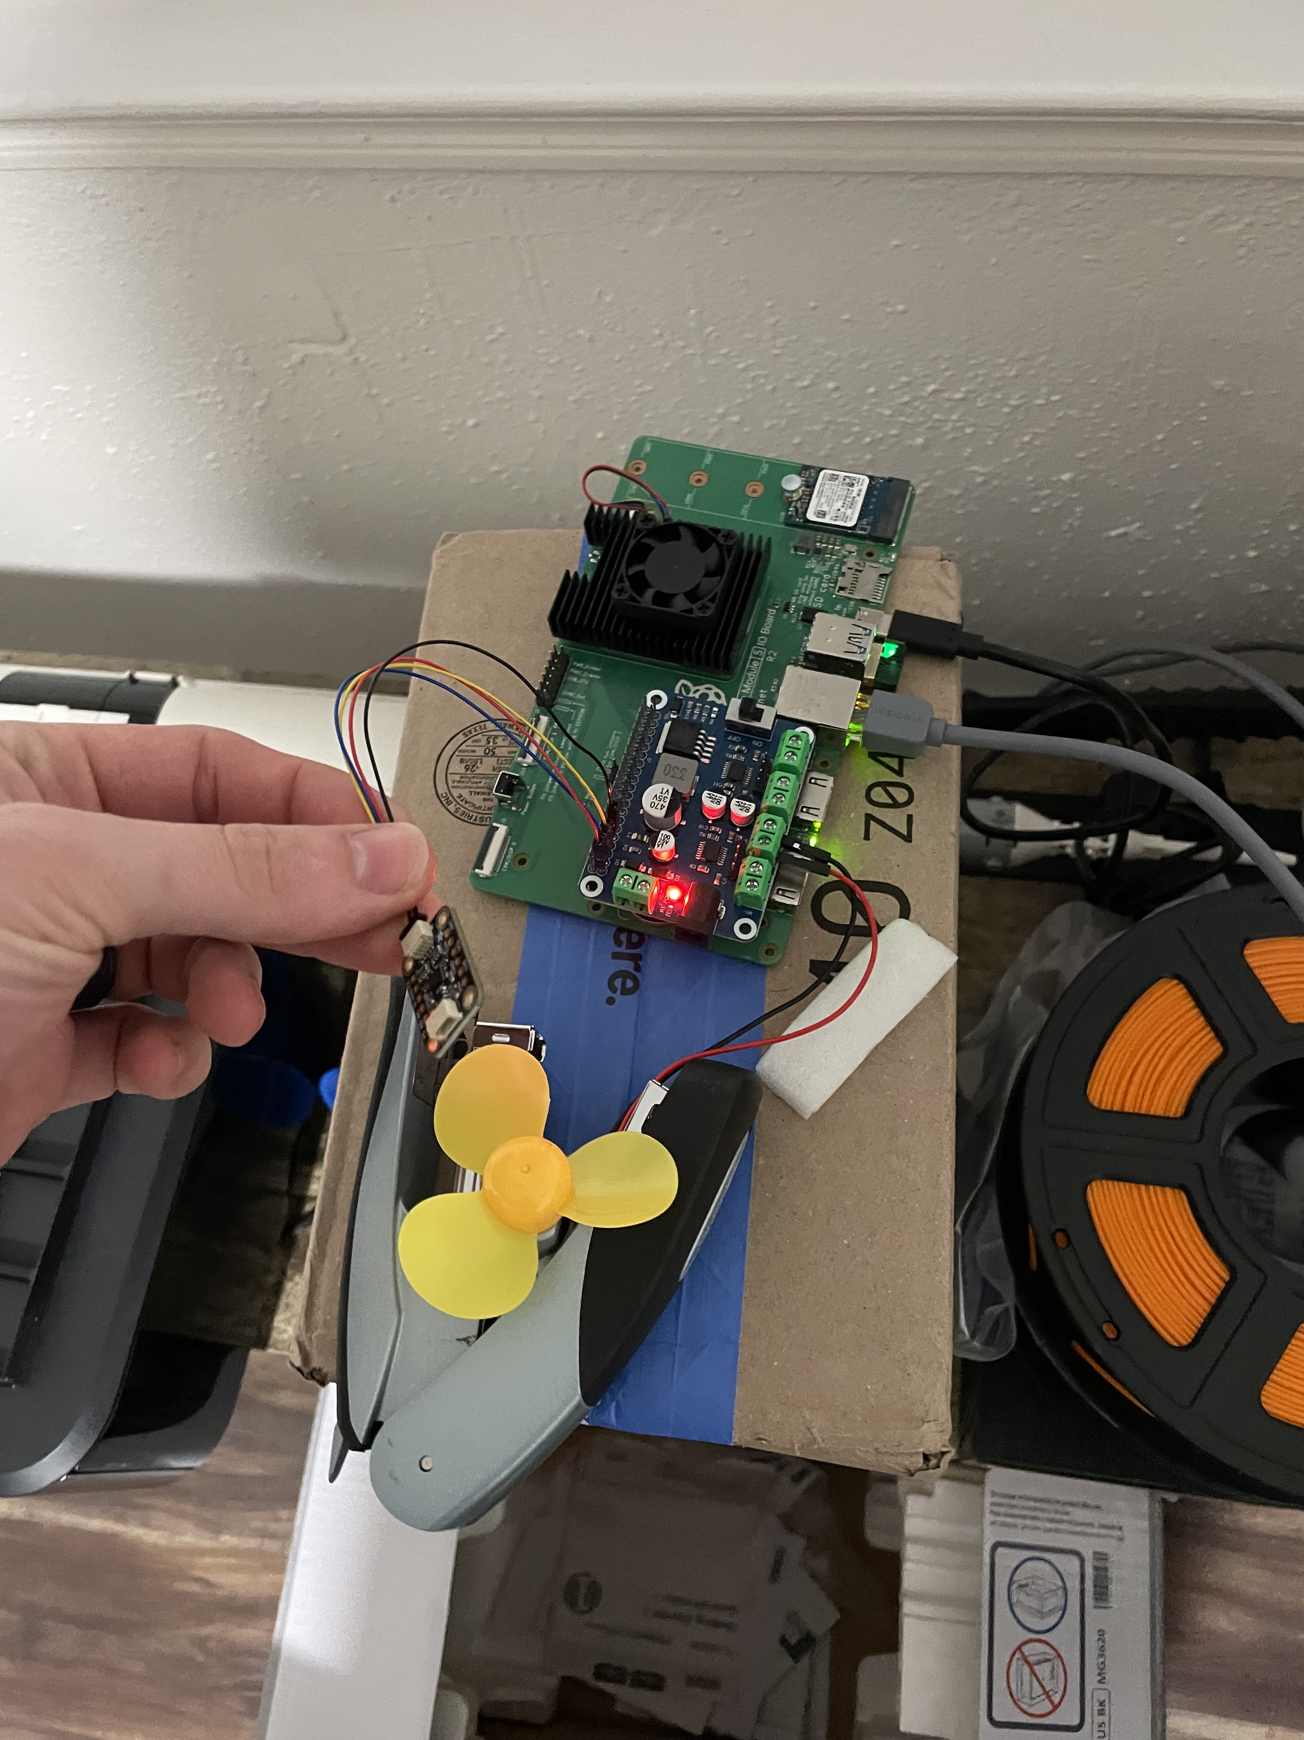
IMU Testing
Verified the measurements and directions that the IMU produced
Implemented IMU over I2C

Slide 3
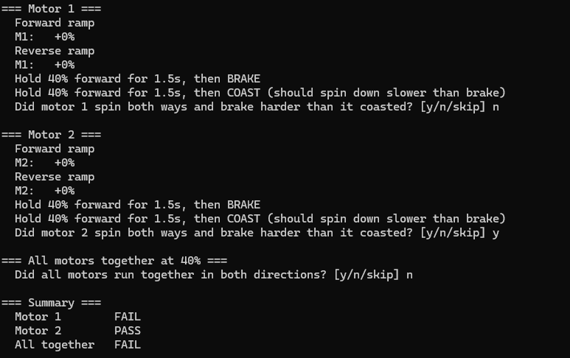
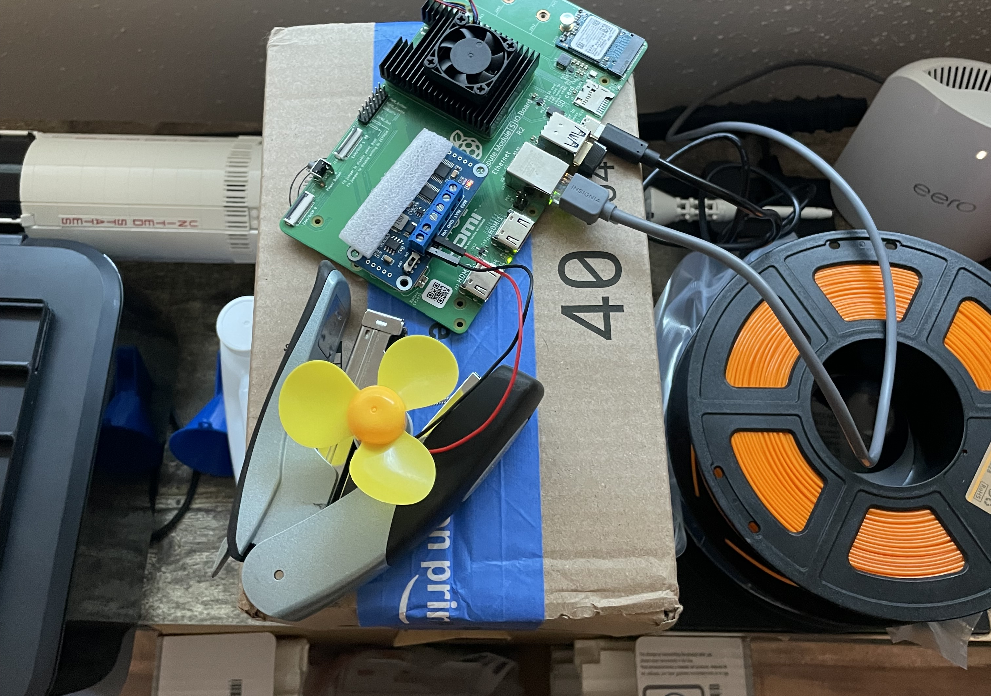
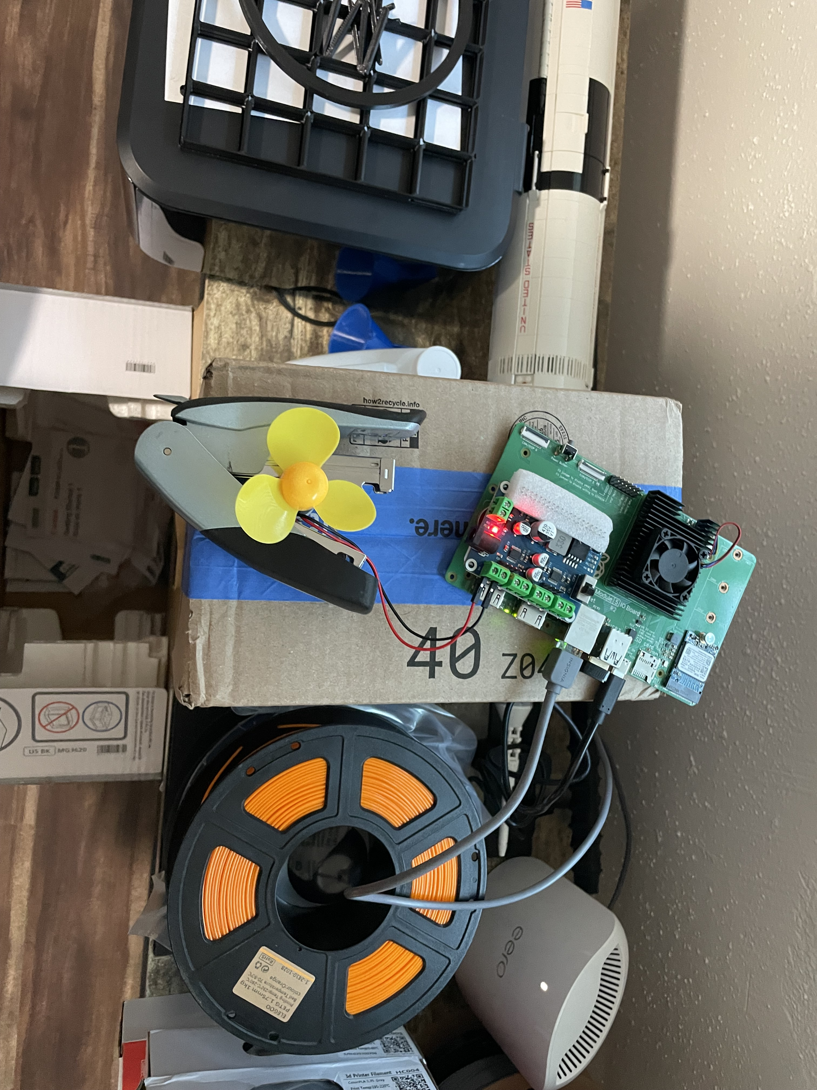
Motor Controller Testing
Tested the motor controller code for operational accuracy
Implemented both HATs over I2C on the 40 pin GPIO header

